Slide 1
P/T Experiment Classical Simulation
By Jason Guo, advised by Professor Filippone
Code located at https://github.com/erfz/pt-experiment

Slide 2
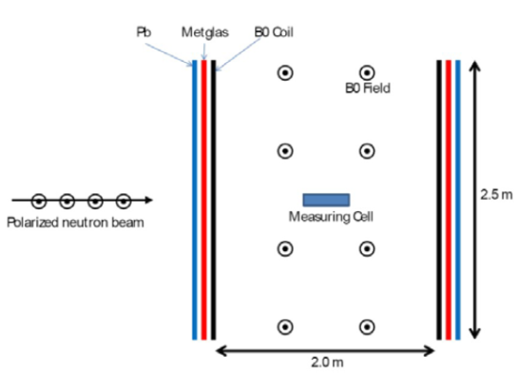
Goal: obtain classical polarization predictions for P/T experiment to compare against empirical results
y
Quantum averages should (hopefully) match up with classical prediction
Must be able to evolve through very different materials (Pb superconductor is simple compared to Metglas)
Default geometry used by simulation shown to the right (easily respecified)
x
z

Slide 3
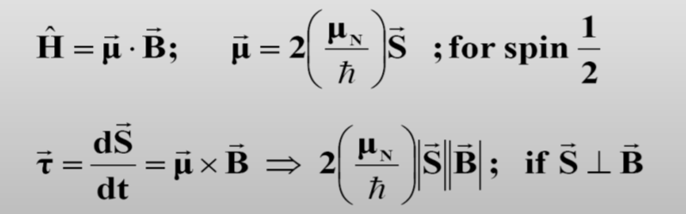
Classical Model using Bloch Equation
Currently evolved using SciPy’s solve_ivp (using LSODA method)
Relative and absolute tolerances of 1e-8 seem to work well
Runge-Kutta (RK45 and DOP853) work as well, albeit slower

Slide 4
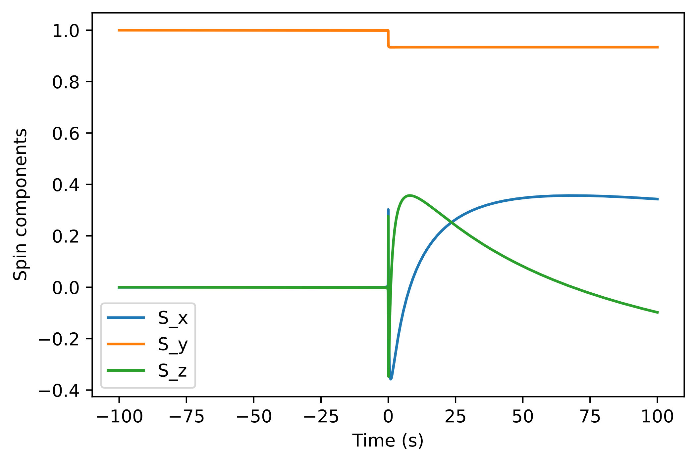
Simulation of particle passing by two wires
y
Top wire
x
z
d/4
d
Bottom wire
Final spin: [0.34317234420034903, 0.9341791942794703, -0.09768236082303823]
Speed: 1000 m/s
Top wire: 10 A
Bottom wire: 10 A
d = 10 meters

Slide 5
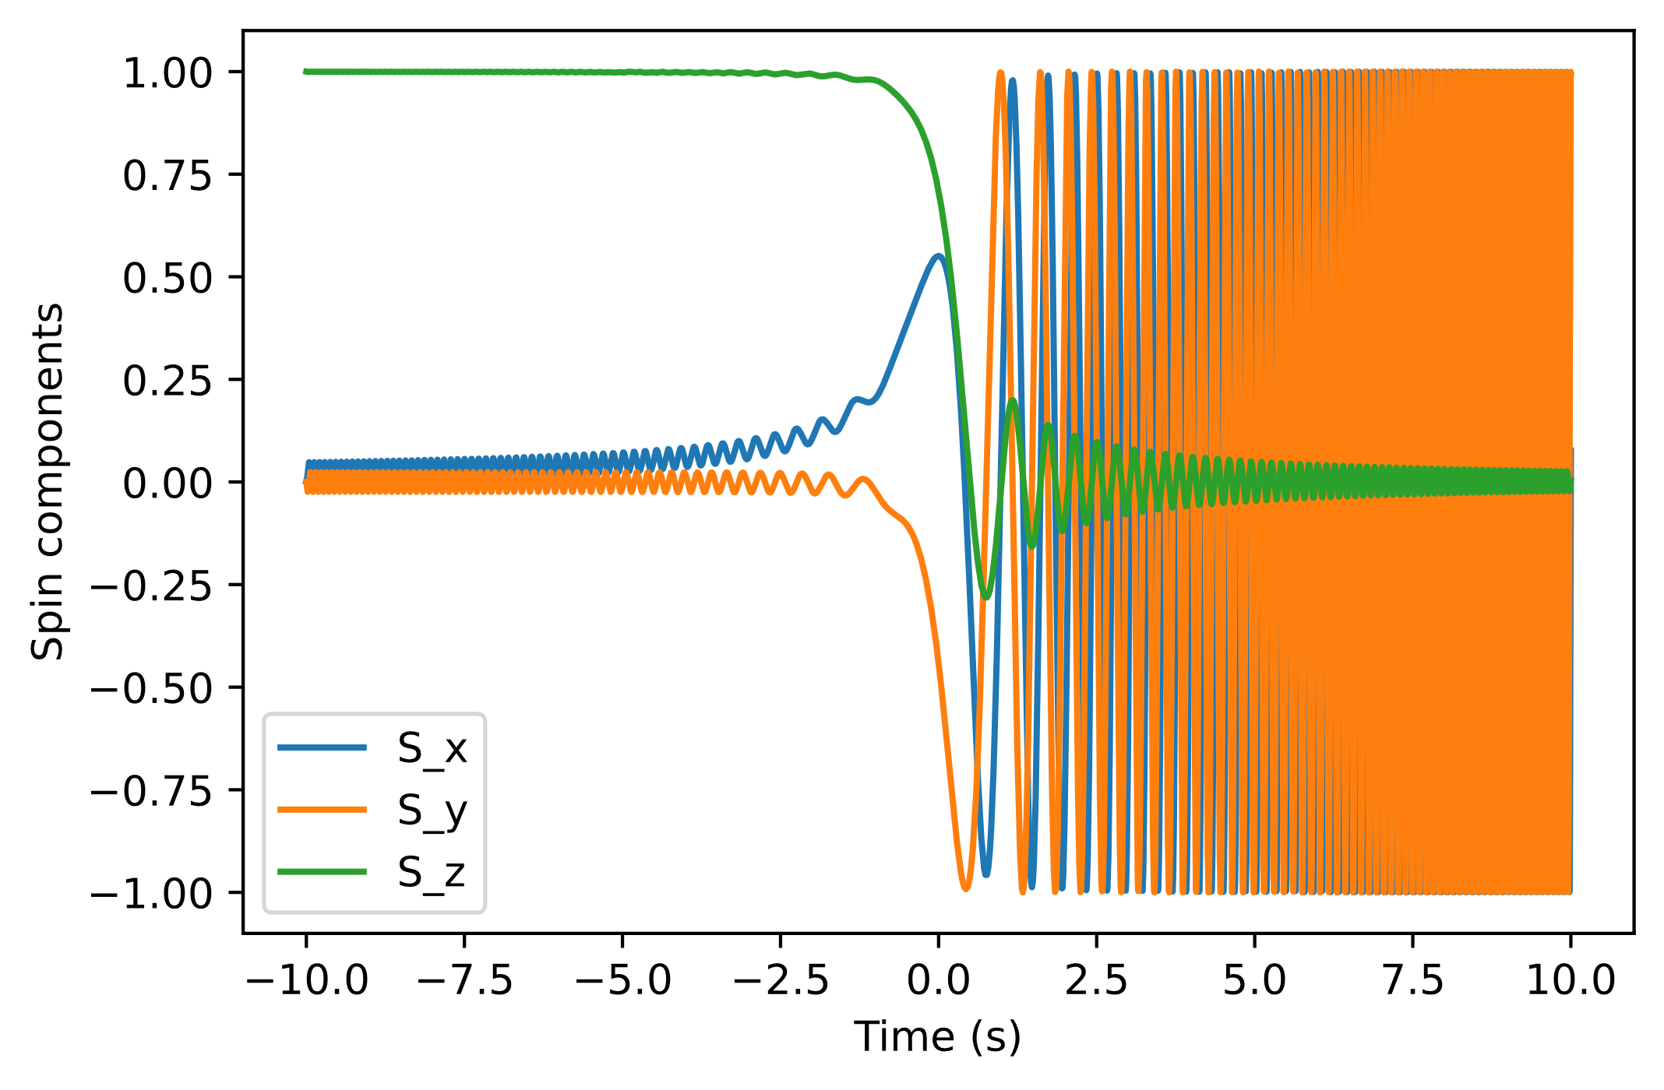
Simulation of particle evolving under Vladimirskii field
Field = [Hx, 0, t * H_dot] with Hx = 10 nT, H_dot = -41.5 nT/s
Final spin: [0.07625445246664814, 0.9970861336744352, 0.003762795417459164]
Corresponding realignment probability: 50.18813977087295%
Theoretical realignment probability: 49.97872272254392%

Slide 6
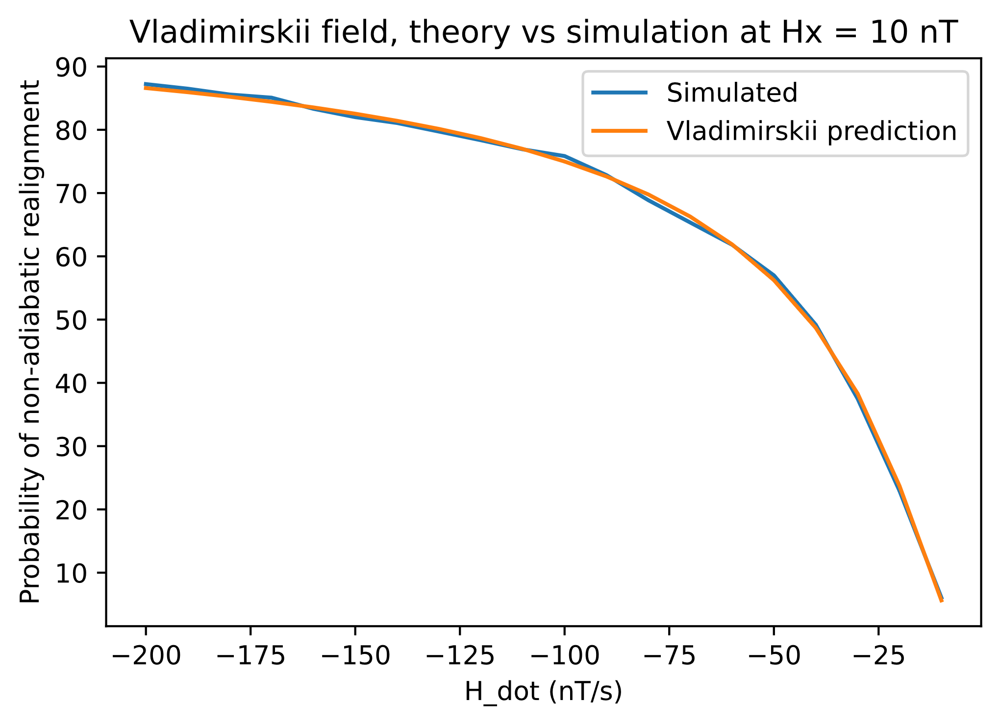
Simulation time at each point: |Hx / H_dot| * 200

Slide 7
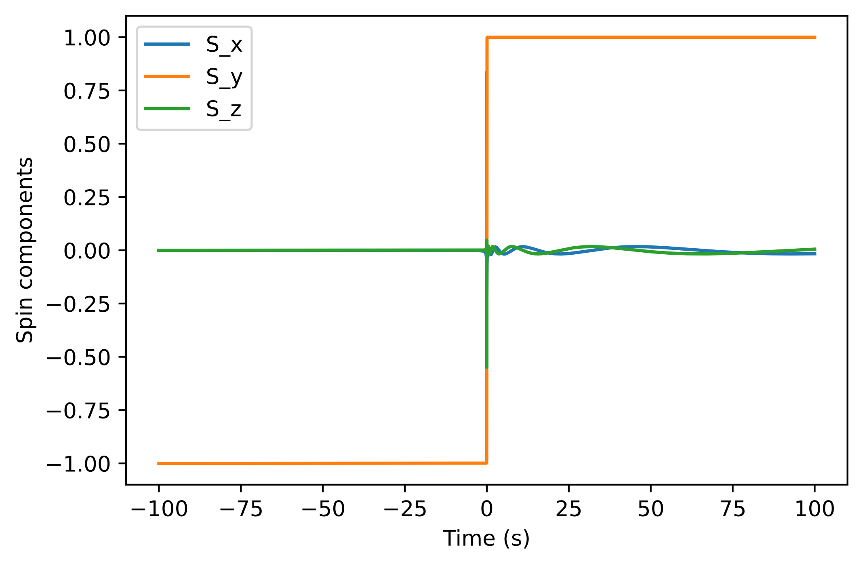
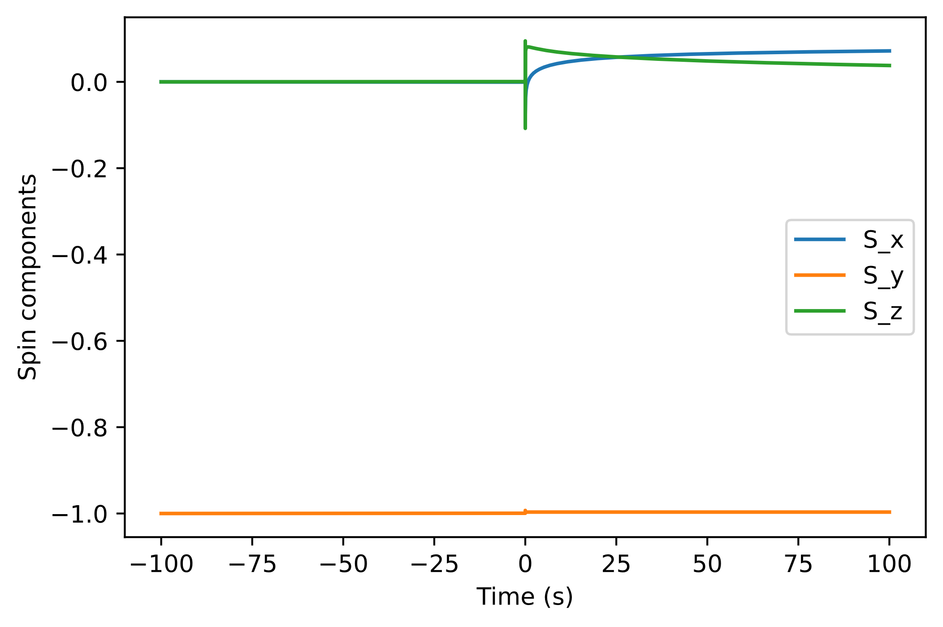
Differing particle speed while passing by two wires
Speed = 5 m/s
Final spin: [-0.01645624340202, 0.999850622344, 0.0052158515616283]
y
Top wire
x
z
2 cm
5 cm
Top wire: 0.3 A
Bottom wire: 0.3 A
Bottom wire
Speed = 100 m/s
Final spin: [0.07166377517344, -0.9967091315968, 0.03788323589709]

Slide 8
Simulating Pb Superconductor
Since the magnetic field inside the superconductor is zero, it is irrelevant from the perspective of the simulation
In particular, the differential equation is proportional to B, so particle spin does not change by passing through the superconductor
Quick simulations verify that the superconductor had no effect

Slide 9
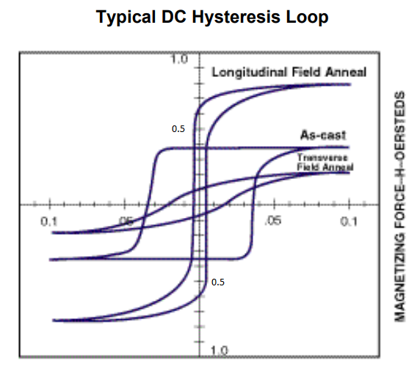
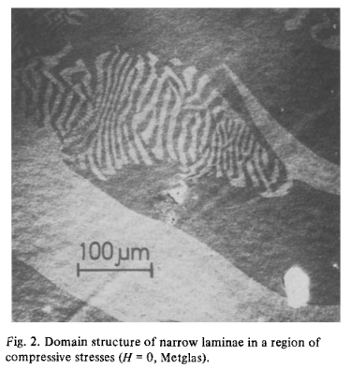
Information about Metglas
Thin, amorphous, ferromagnetic alloy
Specifically using Metglas 2826 (Ni40Fe40P14B6)
2 in wide, 1 km long, 29 microns thick in direction of beam
Not too much is known about domain size, but should be on order of ~10 micrometer along beam direction
For a nominal B0 field (field inside magnet volume) of ~3 μT, Metglas field estimated at ~0.1 T
Ref. 1
Ref. 2

Slide 10
Challenges with Metglas
Much, much stronger field (~0.5 T) compared to other components of the experiment (which are on the order of microtesla)
Strong field coupled with neutron magnetic moment results in many, many oscillations inside the material despite thinness
Must adjust the solver accordingly (very small time steps, small tolerances) in order to properly evolve the system (maintain normalization and “see” every domain)
Difficult to model exactly – domains can have varying sizes and random magnetic field orientations depending on the saturation

Slide 11
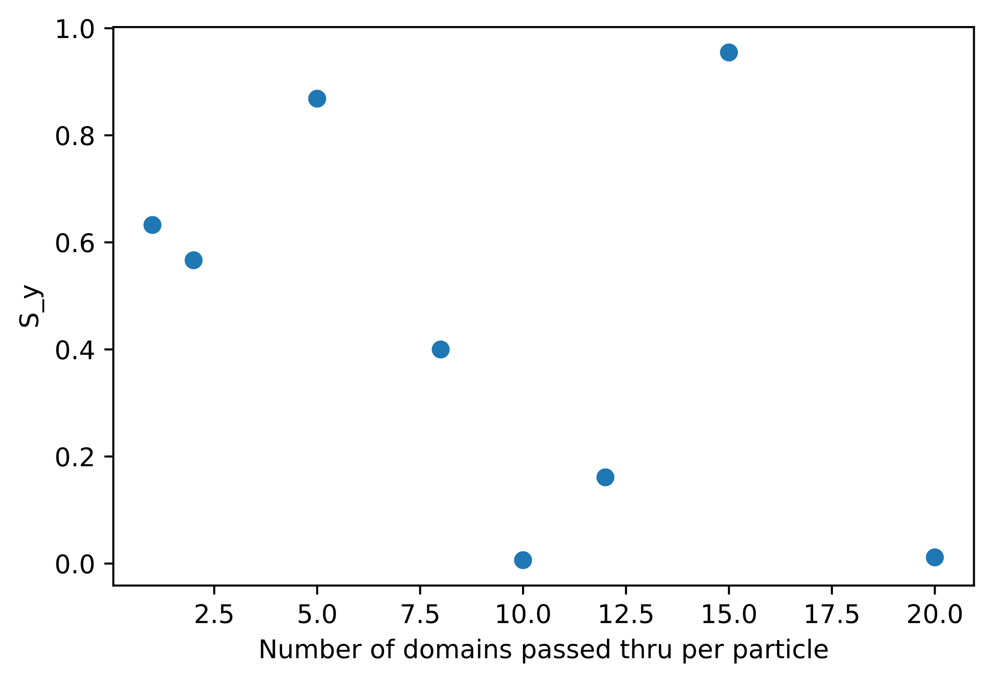
Initial Pitfalls with Metglas
Default scipy solve_ivp tolerances too high
Requires fine-tuning due to relatively large field strength
Loss of normalization when tolerances not small enough
Default scipy time stepping behavior tended to miss Metglas completely;
Requires enforcing maximum time step to hit every domain
Fixed domain size leads to strong resonances (exhibited at 15 domains in plot)
Speed: 100 m/s
Total thickness: 0.1 mm
B = 0.5 T
Saturation = 0.6

Slide 12
Metglas Domain Model
Generated independently for each particle
Domain thicknesses along beam direction allowed within a specified range
Not clear exactly what this range should be
Every domain modeled with fixed field strength B
Field direction in each domain determined by saturation
Probability = saturation of pointing in –y direction (anti-parallel to initial spin)
Otherwise, rotated about x-axis (beam direction) using Uniform(0, 2pi)
y
Saturated
z
Unsaturated
x

Slide 13
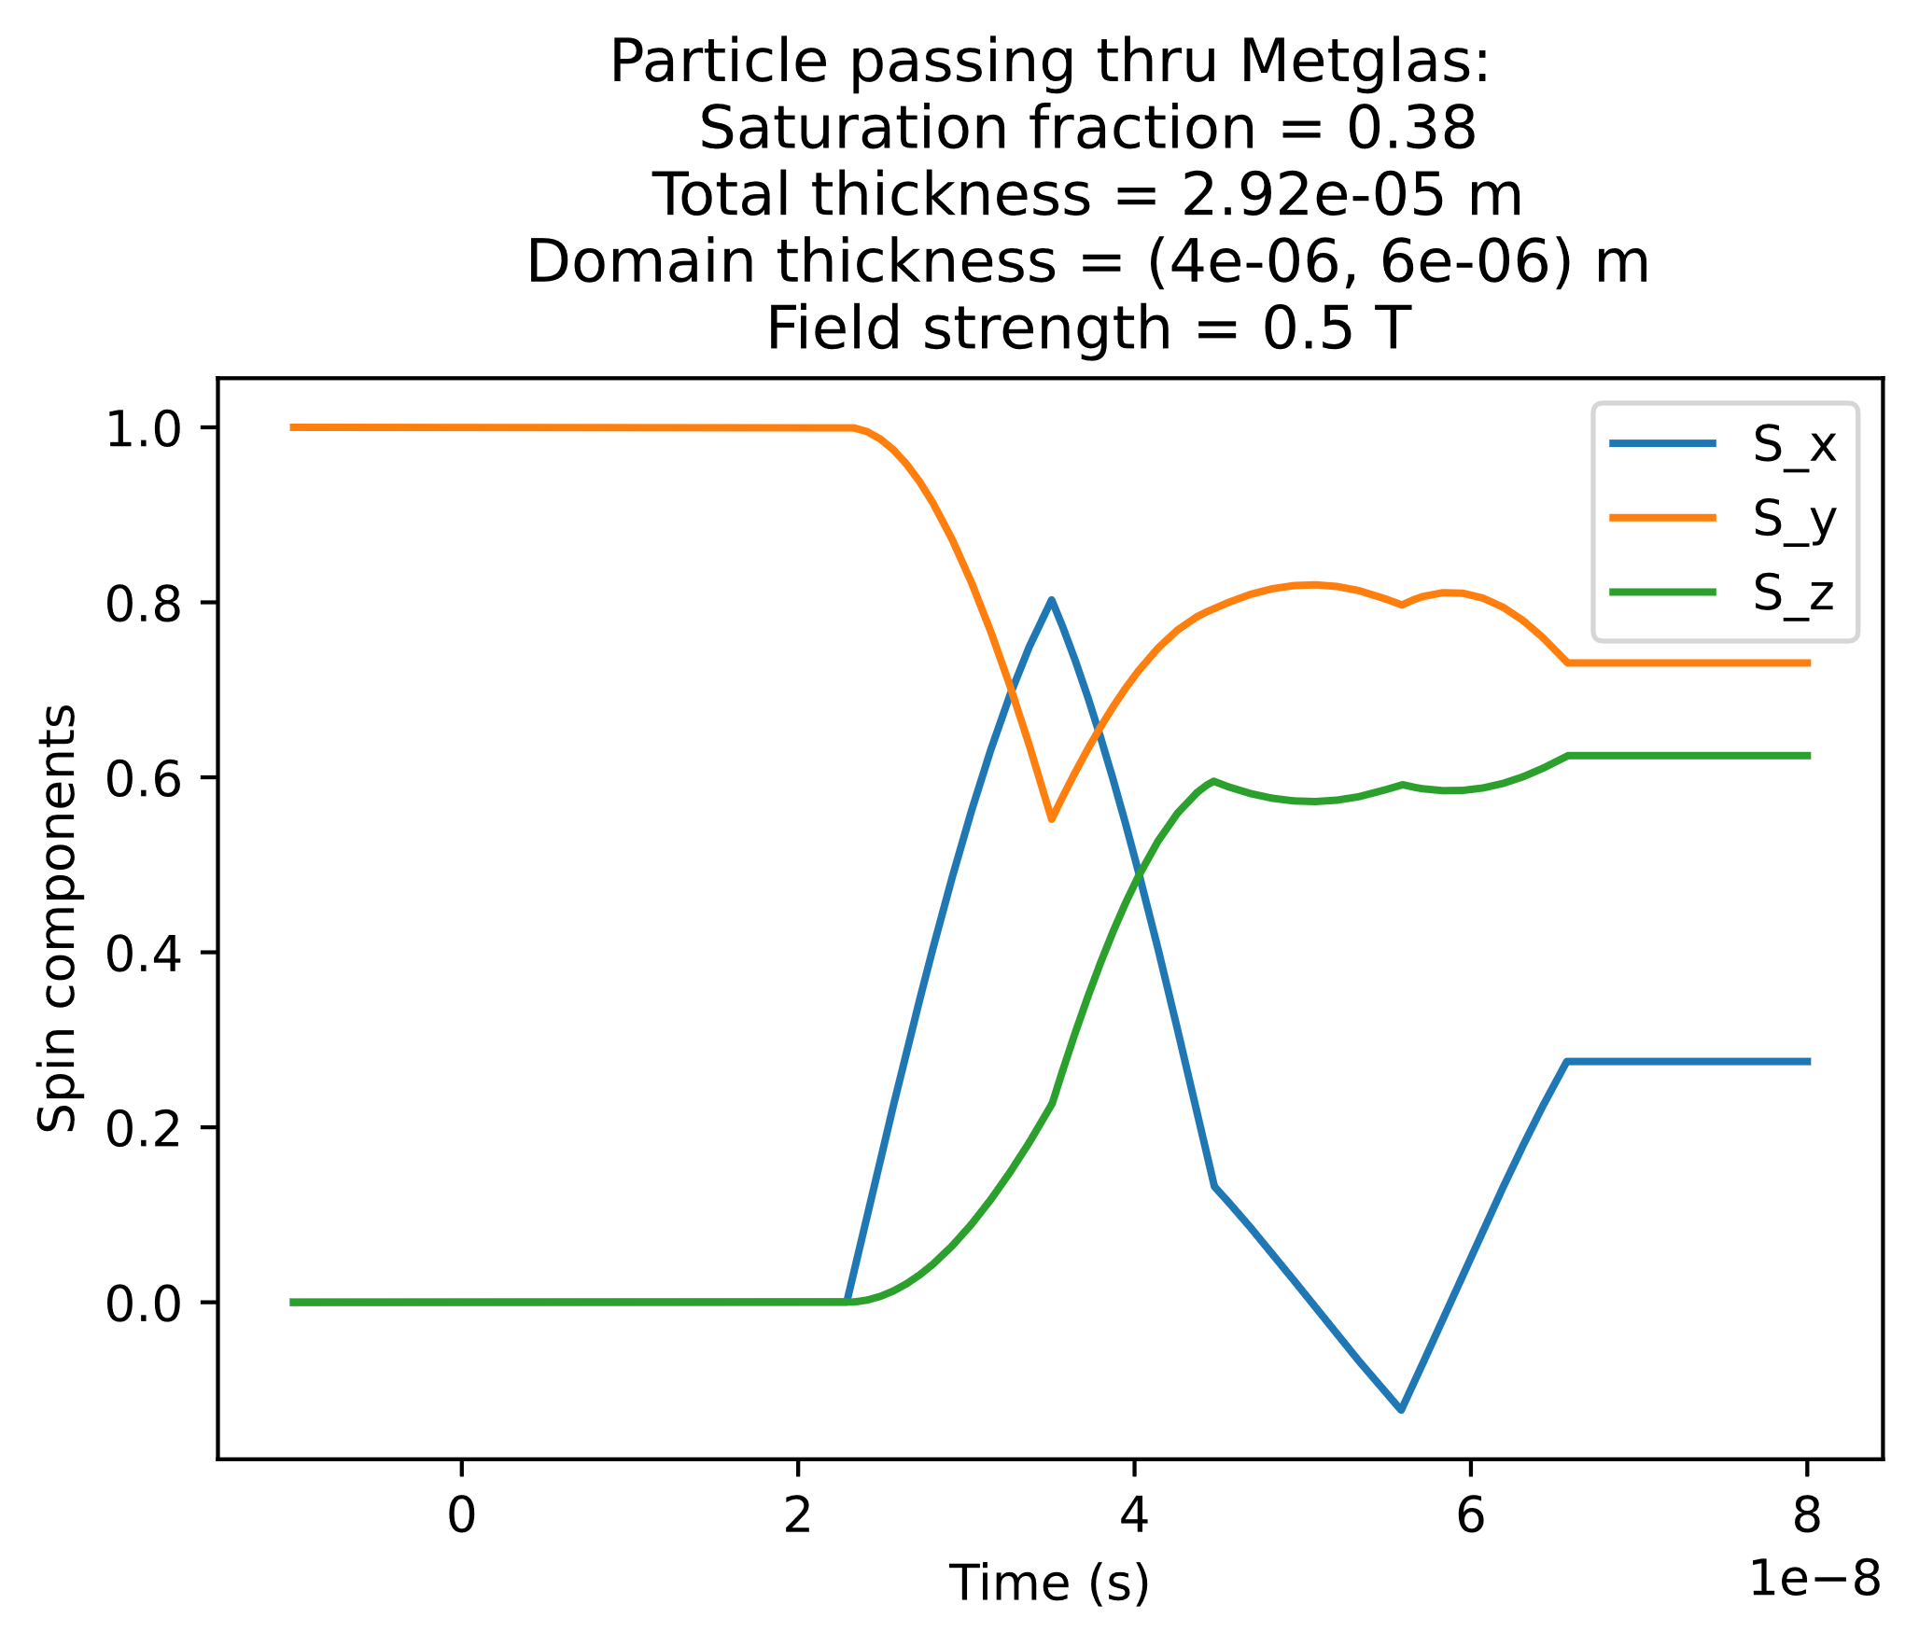
Oscillations within Metglas

Slide 14
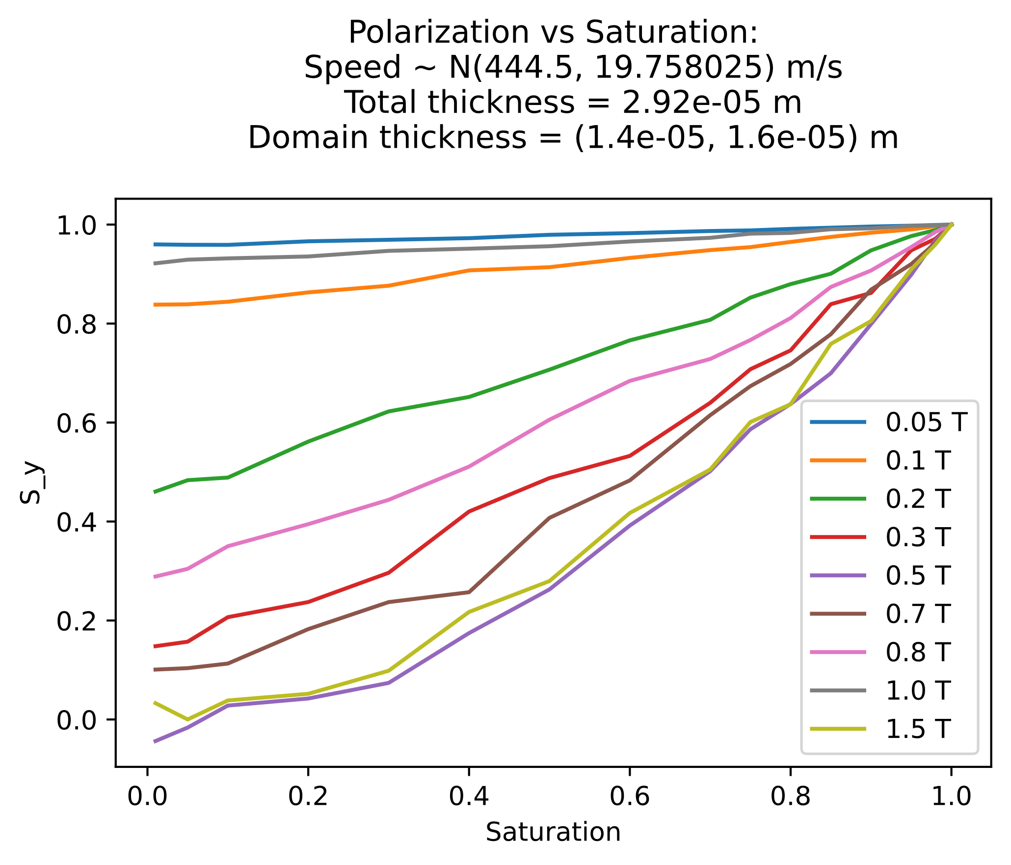
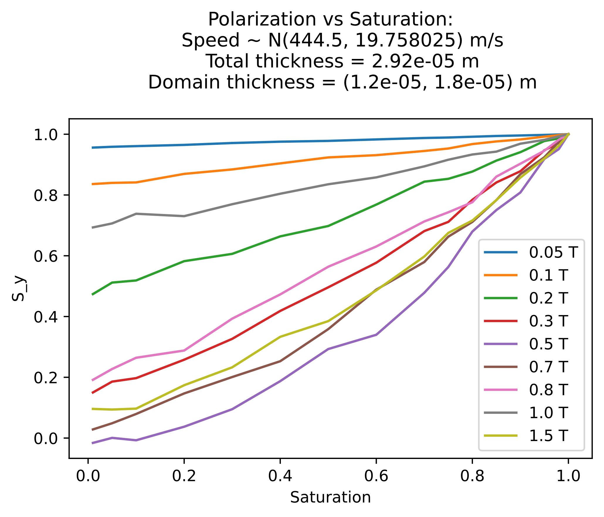
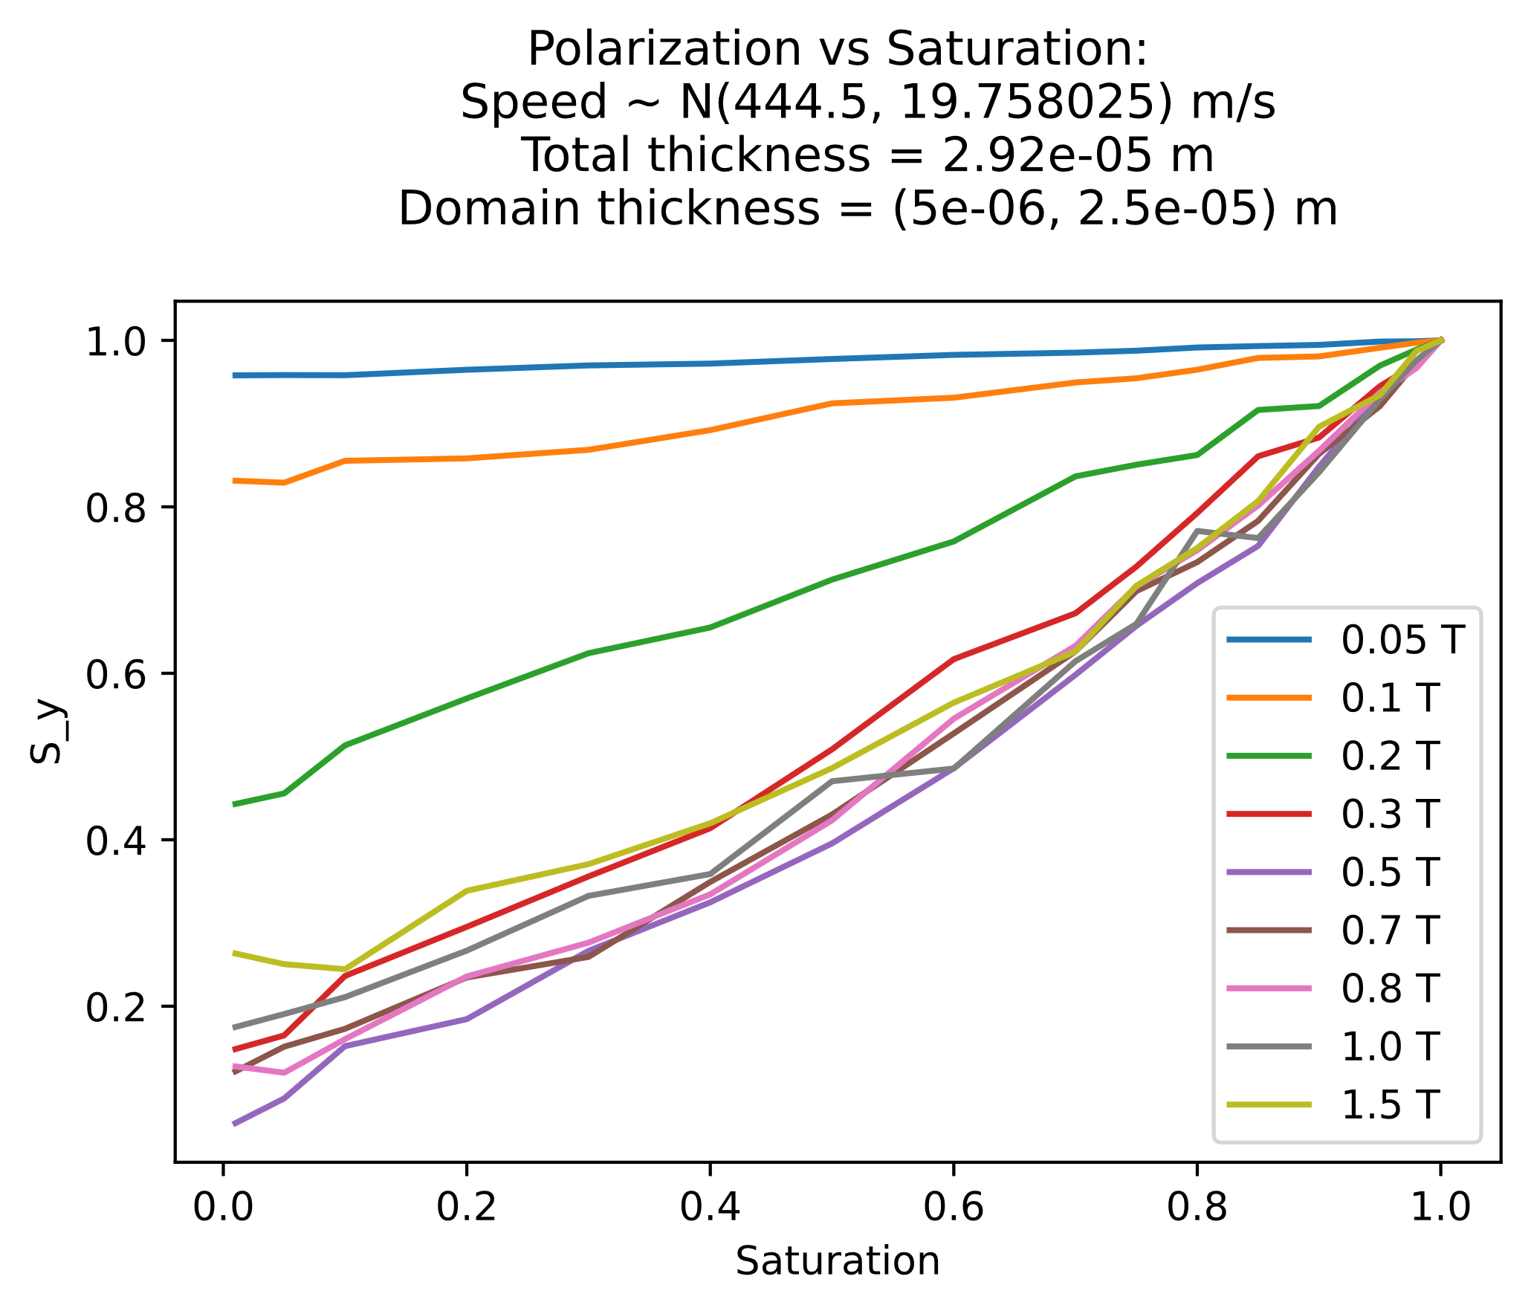
Comparison at same average domain thickness

Slide 15
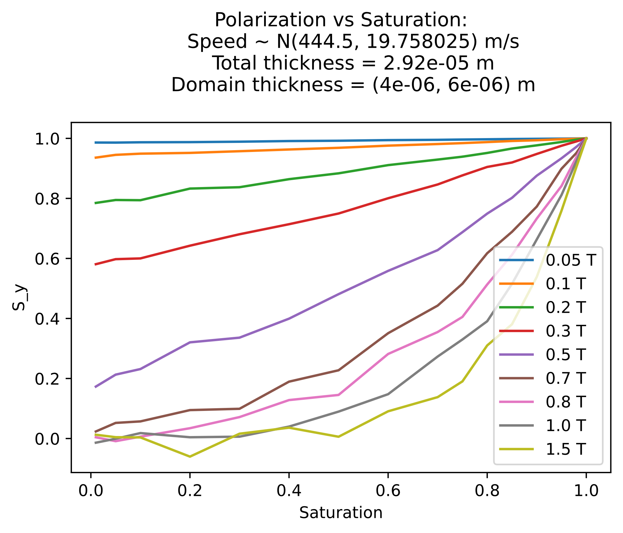

Comparison with similar size of domain range

Slide 16
Next Steps
Further investigate resonance behavior (small range of domain size?)
Find more information on Metglas domain geometry and/or tune domain dimensions to match closely with experimental material data
Allow for cylindrical geometry of materials (currently all materials are rectangular prisms)

Slide 17
References
Ref. 1: Metglas, Inc. Technical Bulletin. Metglas Magnetic Alloy 2826MB (nickel-based). https://metglas.com/wp-content/uploads/2016/12/2826MB-Technical-Bulletin.pdf.
Ref. 2: H. KRONMULLER, M. FAHNLE, M. DOMANN, H. GRIMM, R. GRIMM and B. GROCER, Journal of Magnetism and Magnetic Materials 13 (1979) 53-70.

